Slide 2
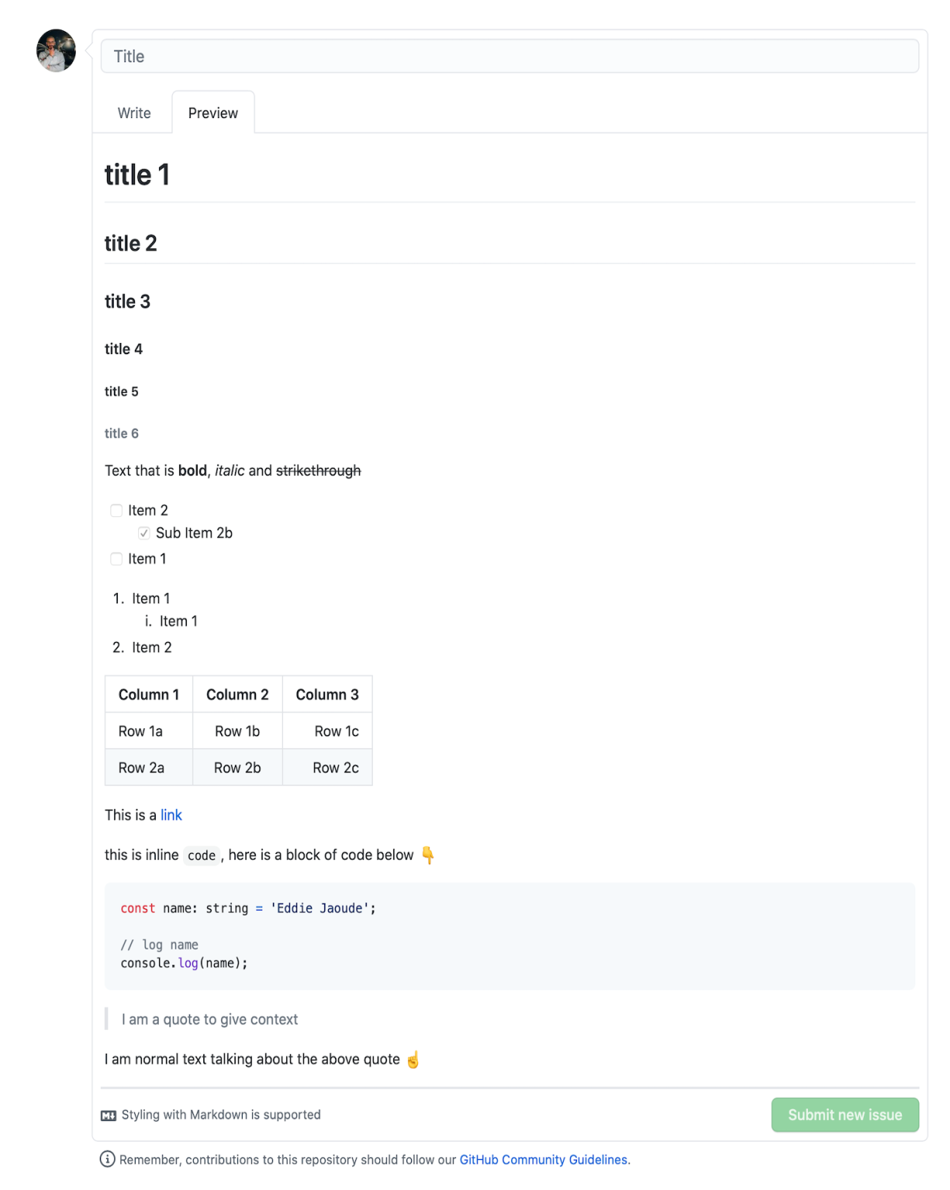
Github customization course
# title 1 ## title 2 ### title 3 #### title 4 ##### title 5 ###### title
6 Text that is **bold**,
*italic*
and ~~strikethrough~~ *
[ ] Item 2 * [x] Sub Item 2b
[ ] Item 1 1. Item 1 1. Item 1 1. Item 2
| Column 1 | Column 2 | Column 3 | | :--- | :---: | ---: | | Row 1a | Row 1b | Row 1c | | Row 2a | Row 2b | Row 2c
| This is a [link](https://mlh.io) this is inline `code`,
here is a block of code below 👇 ```ts const name: string = 'Eddie Jaoude'; // log name console.log(name); ```
> I am a quote to give context I am normal text talking about the above quote ☝️ ☝️

